Slide 1
HW8 Support Material

Slide 2
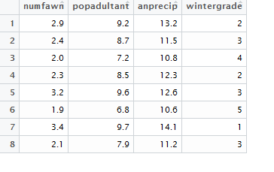
Step 1,2,3 Data set –
Read into R
Change col names to your choice
str

Slide 3
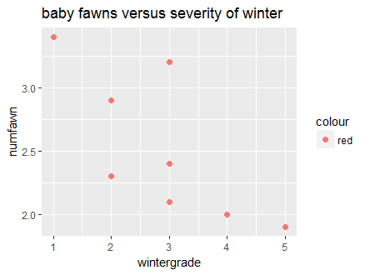
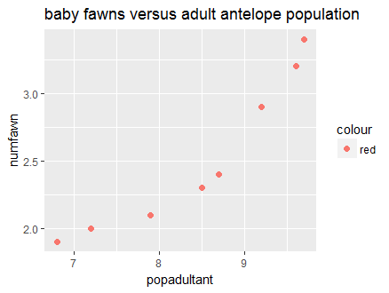
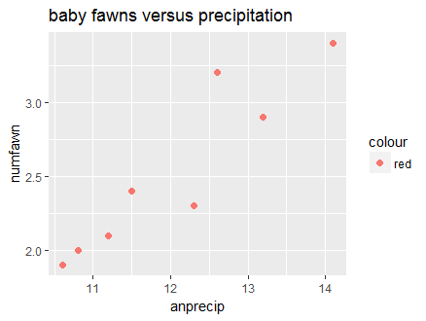
Step 4 - Create bivariate plots

Slide 4
Step 5 – create 3 regression models
model1 - predict the number of fawns from the severity of the winter
model2- predict the number of fawns from the severity of the winter and precipitation
model3 - predict the number of fawns from the severity of the winter, precipitation, adult population
Which model works best and why?
Which of the predictors are statistically significant in each model?

Slide 5
Step 5 - continued
If you wanted to create the most parsimonious model (i.e., the one that did the best job with the fewest predictors), what would it contain? How did you arrive at this decision ?

